Slide 1
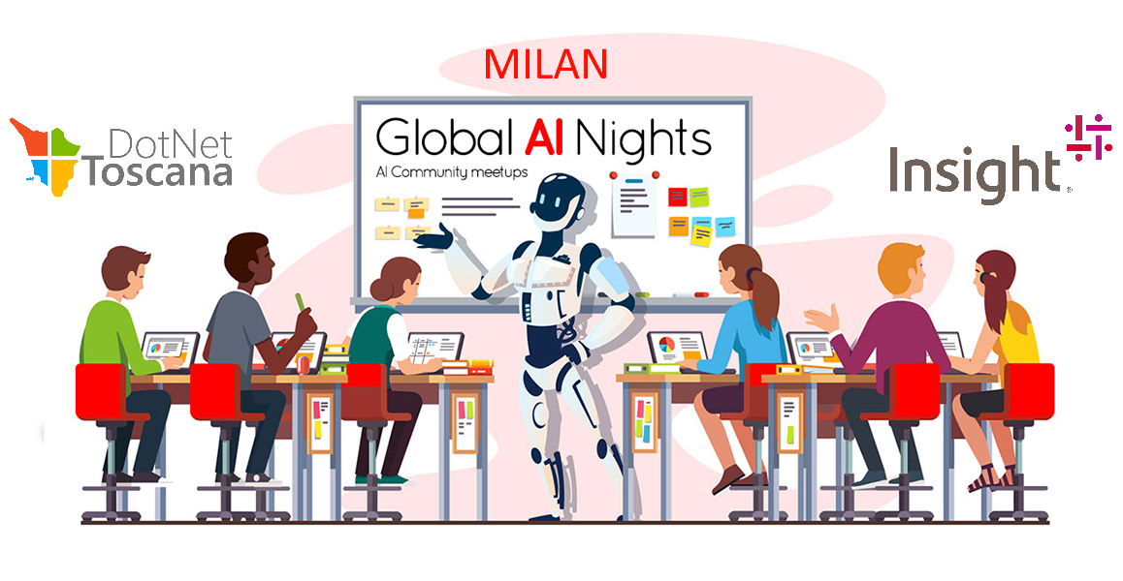

Slide 2


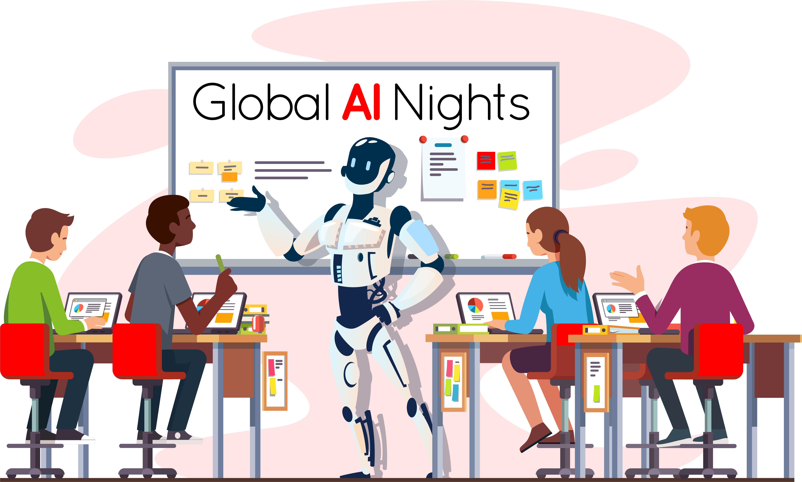


AI … on the Edge!
Riccardo Cappello Senior ICS Consultant @ Insight
Microsoft Azure MVP
Intel Software Innovator

Slide 3
As a developer, why should I care about AI and ML?

Slide 4




Some problems are difficult to solve using traditional algorithms and procedural programming.
Identify objects and people in photos and videos
Recommend products to your users based on historical data
Detect failures in an industrial process before they happen
Navigate autonomously around obstacles and
obey traffic laws
Notes:
Any technology user today has benefitted from machine learning.
Facial recognition technology allows social media platforms to help users tag and share photos of friends.
Recommendation engines, powered by machine learning, suggest what movies or television shows to watch next based on user preferences.
Manufacturing processes contain sensors that collect vast amounts of data and are able to predict failures and react in real time.
Self-driving cars that rely on machine learning to navigate are already being tested and may soon be available to consumers.
In our projects, we are often asked to solve very hard problems.
These three problems have something in common – they are relatively easy for a human to solve, but are difficult to program a computer to do.
This is especially true, when the only tool available for us is procedural code and traditional algorithms.
This is where AI can help!

Slide 5
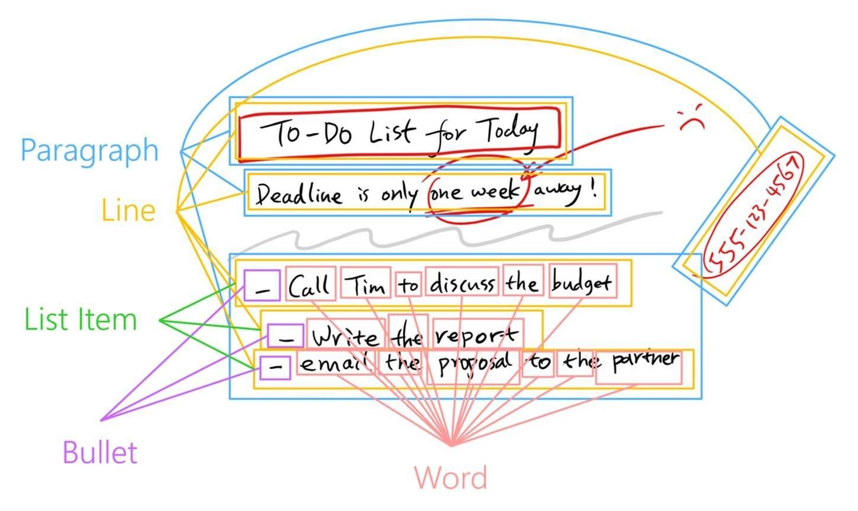
AI solves hard problems
Smart Ink​
Classify strokes as text, shapes, freehand drawings​
Classify text into words, paragraphs, lines, bullets​
Extract entities: phone numbers, names, dates​
Assign meanings: date references, known contacts
Notes:
Let me show you an example of a problem that Microsoft uses AI to solve.
Using AI techniques - the Windows Ink platform can assign conceptual meaning to physical ink strokes
Let’s look at the process:
Windows Ink can identify which ink strokes represent text
Knowing this, It can then classify that text into categories – this is a word, this is a sentence, this is a complete paragraph, this is a set of list items.
With this context, we can use ink to identify contextual entities like names, times, and phone numbers and start operating on conceptual objects like contacts and schedules.
These conceptual connections are very difficult to make without AI

Slide 6
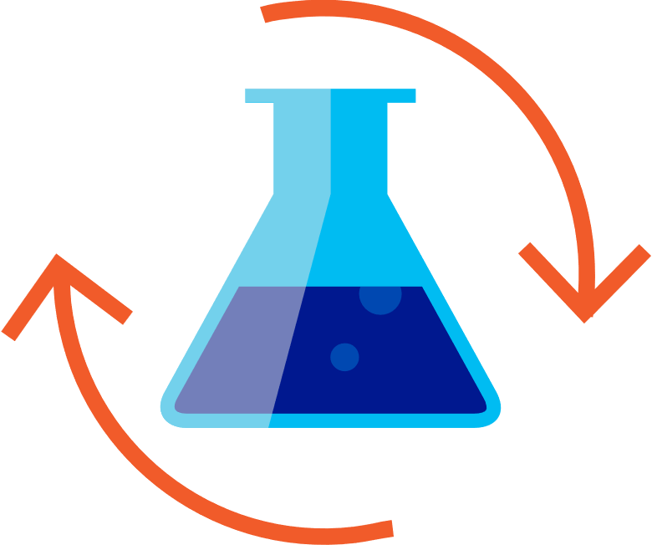

Get started with machine learning
Prepare Data
Build & Train
Evaluate
Azure Databricks
Azure Machine Learning
In the cloud – on the edge
Quickly launch and scale Spark on demand
Rich interactive workspace and notebooks
Seamless integration with all Azure data services
Broad frameworks and tools support: TensorFlow, Cognitive Toolkit, Caffe2, Keras, MxNET, PyTorch
Docker containers
Windows Machine Learning
Notes:
Let’s take a look at the end-to-end cycle of creating and using machine learning models.
At Microsoft, we’ve been investigating AI solutions for a while, and we’ve worked with developers across industries who use AI solutions.
Many of Microsoft’s AI investments are in the Azure Cloud:
Machine Learning is a power tool to help us answer specific questions. We need to understand what question we’re striving to bring clarity to. Once we’ve defined the question we want to answer, we must identify a set of labelled data which can help us answer this question. Azure Databricks combines the best of Databricks and Azure to help customers accelerate innovation with one-click set up, streamlined workflows, and an interactive workspace that enables collaboration between data scientists, data engineers, and business analysts.
Azure Machine Learning allows you to use broad frameworks and tools to build and train the model, including frameworks such as TensorFlow, Cognitive Toolkit, PyTorch and more. It allows you to scale training to 100Ks servers and use –prebuilt AI model packages for Computer Vision, Text, and forecasting
Once you’ve trained a model, you can deploy it to a service to use from the cloud or use it locally on the Edge.
For the rest of this talk, we will focus on using pre-trained models on the Edge and on Windows

Slide 7
AI on the edge
Low latency
Scalability
Flexibility
Notes:
Azure AI solutions can really help you use AI to solve your hard problems, but sometimes developers also need AI Capabilities on the Edge.
Low Latency
When scenarios require real-time, low latency results. This is critical, when your analyzing images in a video, running AI in a game engine, or handling background tasks like search.
Scalability
When you already have a service that’s running at scale, AI on the edge enables you to add intelligence to your service while optimizing your operational cost. You are not paying for GPU usage for every AI operation, but one for AI training.
Flexibility
Moving AI processing to the device is really important when data can't be sent to the cloud - due to poor connection, size, policy, or simple customer preference.

Slide 8
Azure Custom Vision
Demo
Notes:
Follow CustomVision and AlarmML demo steps found in the demo repository on Github: https://github.com/Microsoft/InsiderDevTour18-ML

Slide 9
More edges with Custom Vision

Slide 10
Custom Vision models targets
CoreML
iOS 11 & later
TensorFlow
Android
ONNX
Windows ML
Dockerfile
Azure IoT Edge, Azure Functions, AzureML

Slide 11
Custom Vision offline models with iOS & Android
Demo

Slide 12
AI on Docker
Demo

Slide 13
AI on Raspeberry Pi with Docker
Demo

Slide 14
References
https://onnx.ai
https://gallery.azure.ai/models
https://customvision.ai
https://azure.microsoft.com/en-us/blog/running-cognitive-service-containers/
https://github.com/DotNetToscana/CustomVisionCompanion

Slide 15
GRAZIE!
Riccardo Cappello Senior ICS Consultant @ Insight
Microsoft Azure MVP
Intel Software Innovator

